Slide 1
Color Switch
CSE201: Advanced Programming
Saatvik Bhatnagar 2019097
Aryan GD Singh 2019459

Slide 2
Implementation and Features
Navigation through menus is done using FXML files.
On starting the game, the database is loaded in, and on exiting it data is saved.
You can create different players for different people.
High Scores, sorted by difficulty then score can be seen.
Load game allows player to load their saved games.
Buy new types of balls in the shop.
Standard game has 3 difficulty levels, or try out the extra game mode: Frenzy.
Game becomes progressively harder with time.
In standard mode you can save your game, or even continue after colliding with obstacle using collected stars.

Slide 3
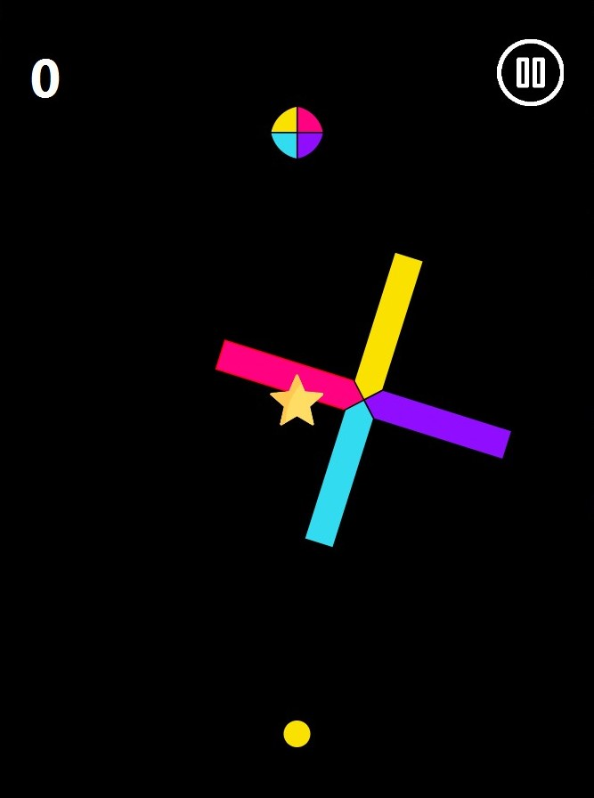
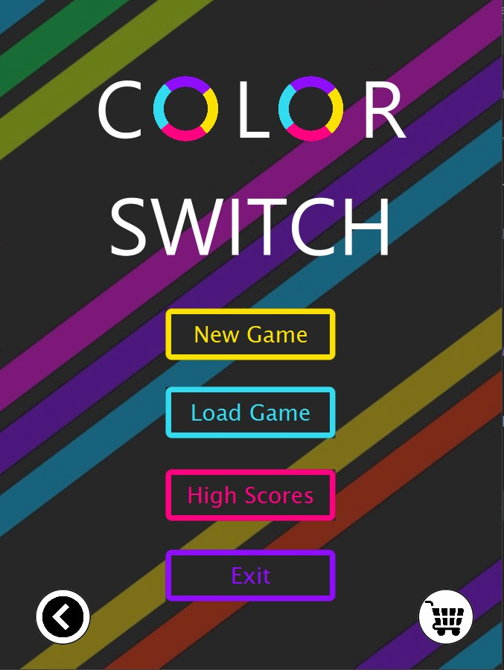
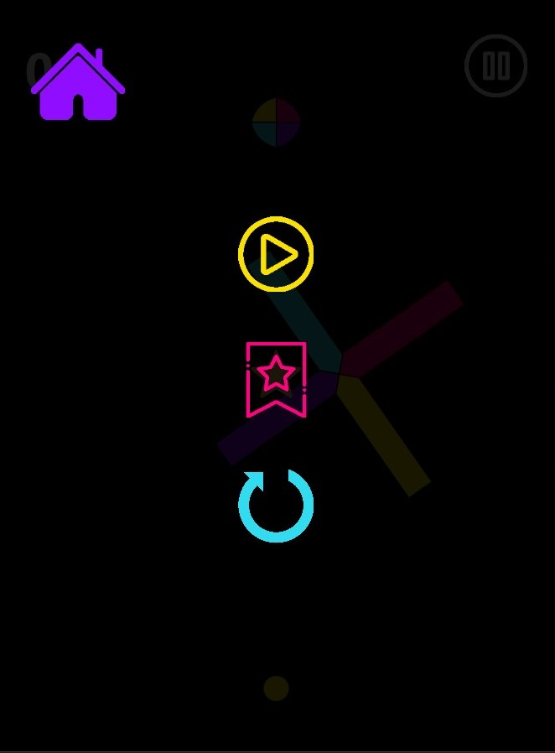
Design
Extensive use of OOP principles
abstract classes Obstacle, GameElement
Inheritance and Polymorphism
Encapsulation, Comparator
Use of template and facade Design pattern in Obstacle creation
Use of iterator design pattern while checking for obstacle collision
Use of Memento design pattern while saving the game
Facade for menu based access
UI: using Scene Builder
Image sources: flaticon

Slide 4
Individual Contributions
Saatvik
Ingame event handling
Transitions and animations
Creating Obstacles designs
Extra game mode, frenzy
Difficulty setter
Pause Menu
Rendering game elements
Infinite obstacles, stars generation
Adding ingame sounds
Aryan
FXML: UI design and implementation
GUI: All buttons and backgrounds
Save Game: Serialization & Deserialization
Shop
Revive functionality
Continue functionality
UML diagrams
Player list and highscores functionality
Bug fixing/Code refactoring
Presentation

Slide 5
Bonus Features
An extra game mode - frenzy.
High Scores are stored and can be viewed from Main Menu.
Player List, playing with a certain player does not affect the other players.
Difficulty choice, get a tougher experience if you want it.
Shop to buy different types of balls.
In game sounds for a better experience.
It is possible to restart game from pause menu.
Six types of obstacles.
Information page, for when you want to get in touch with the creators.

Slide 6
Problems Faced
Initially due to high number of obstacles the rotate timeline was causing problems, then we changed the array to a constant size with elements being dynamically added and removed
Reviving was causing an error due to collision happening instantly after revival so we removed the obstacle altogether
The perspective camera was causing the obstacles to tinker, so instead of moving the camera, the obstacles, stars and color changers were moved down by a certain distance
Loading a saved game lead to problems in high scores as the same save could lead to multiple instances of high scores. To solve this each saved game was given a state ID which was used to store the high score.

